Slide 1
Circle Detection with Hough Transform
M. Rizqi Mubarak
Reiza Ramadhan
Yusril Firza

Slide 2
Circle Detection
Circle Detection Using Metaheuristics
Harmony Search Optimisation
Classical Hough Transform Based Circle Detection

Slide 3

Radon Transform
The Radon transform is a mathematical integral transform, defined for continuous functions on ℝ𝑛 on hyperplanes in ℝ𝑛. The Hough transform, on the other hand, is inherently a discrete algorithm that detects lines (extendable to other shapes) in an image by polling and binning (or voting).

Slide 4
Harmony Search Optimisation
Harmony search algorithm is one unprecedented metaheuristic algorithm which is useful in the process of searching optimized answers in optimization problems and is among meta-heuristic algorithms that are developed for optimization through the continuous space

Slide 5
Canny Edge
The Process of Canny edge detection algorithm:
Apply Gaussian filter to smooth the image in order to remove the noise
Find the intensity gradients of the image
Apply non-maximum suppression to get rid of spurious response to edge detection
Apply double threshold to determine potential edges
Track edge by hysteresis: Finalize the detection of edges by suppressing all the other edges that are weak and not connected to strong edges.

Slide 6
Haugh Transform
This method assumes that the edge pixels of the image have already been identified using one of the many edge detection methods, for example, the Canny edge detector.
Notes:
The classical way to do circle detection is using the circular Hough transform. This method assumes that the edge pixels of the image have already been identified using one of the many edge detection methods, for example, the Canny edge detector. The collection of edge pixels, called the edge map, is then processed to identify which of the pixels is part of a circle by transforming the edge pixels into a 3D parameter matrix called the Hough parameter space.

Slide 7
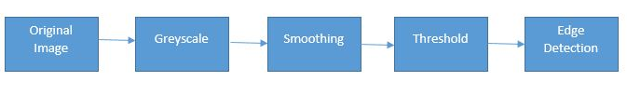
Edge Detection

Slide 8
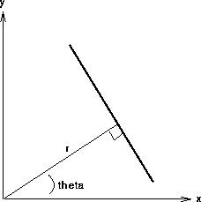

A line in the image space can be expressed with two variables in different systems
y = mx + b

Slide 9
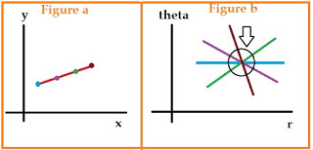
This is the figure in cartesian coordinate system

Slide 10
How it Works
Let's take the first point(blue), find the values of x and y for this point. Put these values in polar coordinates equation (2).
Draw a line in polar coordinates plane for the values of x and y and varying ∅, as shown in figure b (blue line).
Repeat these steps for other three lines.
Now if these points belong to a same line, they will meet a common point in polar coordinates. The more number of points the line have the more will be lines intersecting at the common points.
The next step is to set a threshold. This threshold is imposed on the number of lines passing from the common point. This will set a min length of the line which are going to be detected

Slide 11
We can use this same procedure to detect other features with analytical descriptions. For instance, in the case of circles, the parametric equation is

Slide 12
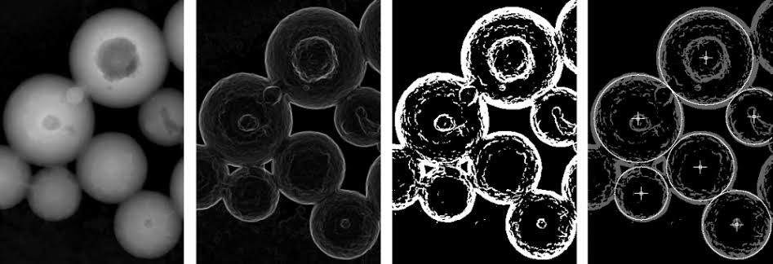
Example

